Slide 1
Sprint Review 6
EDA Gone Rogue
Scraping and Parsing Income Data from the Web
By: Victoria Larson

Slide 2
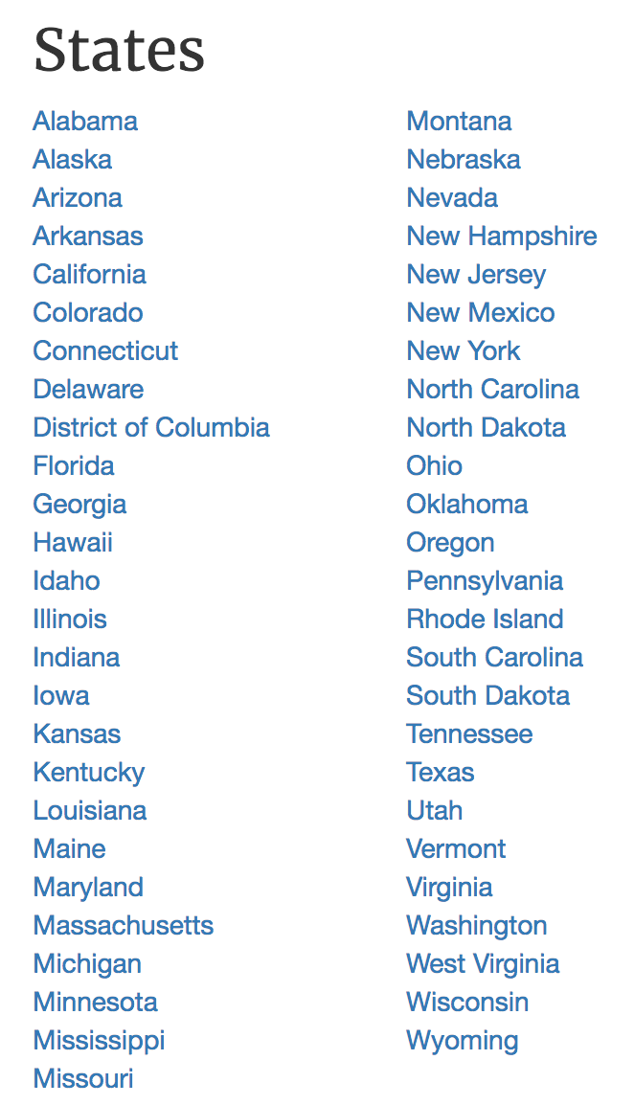
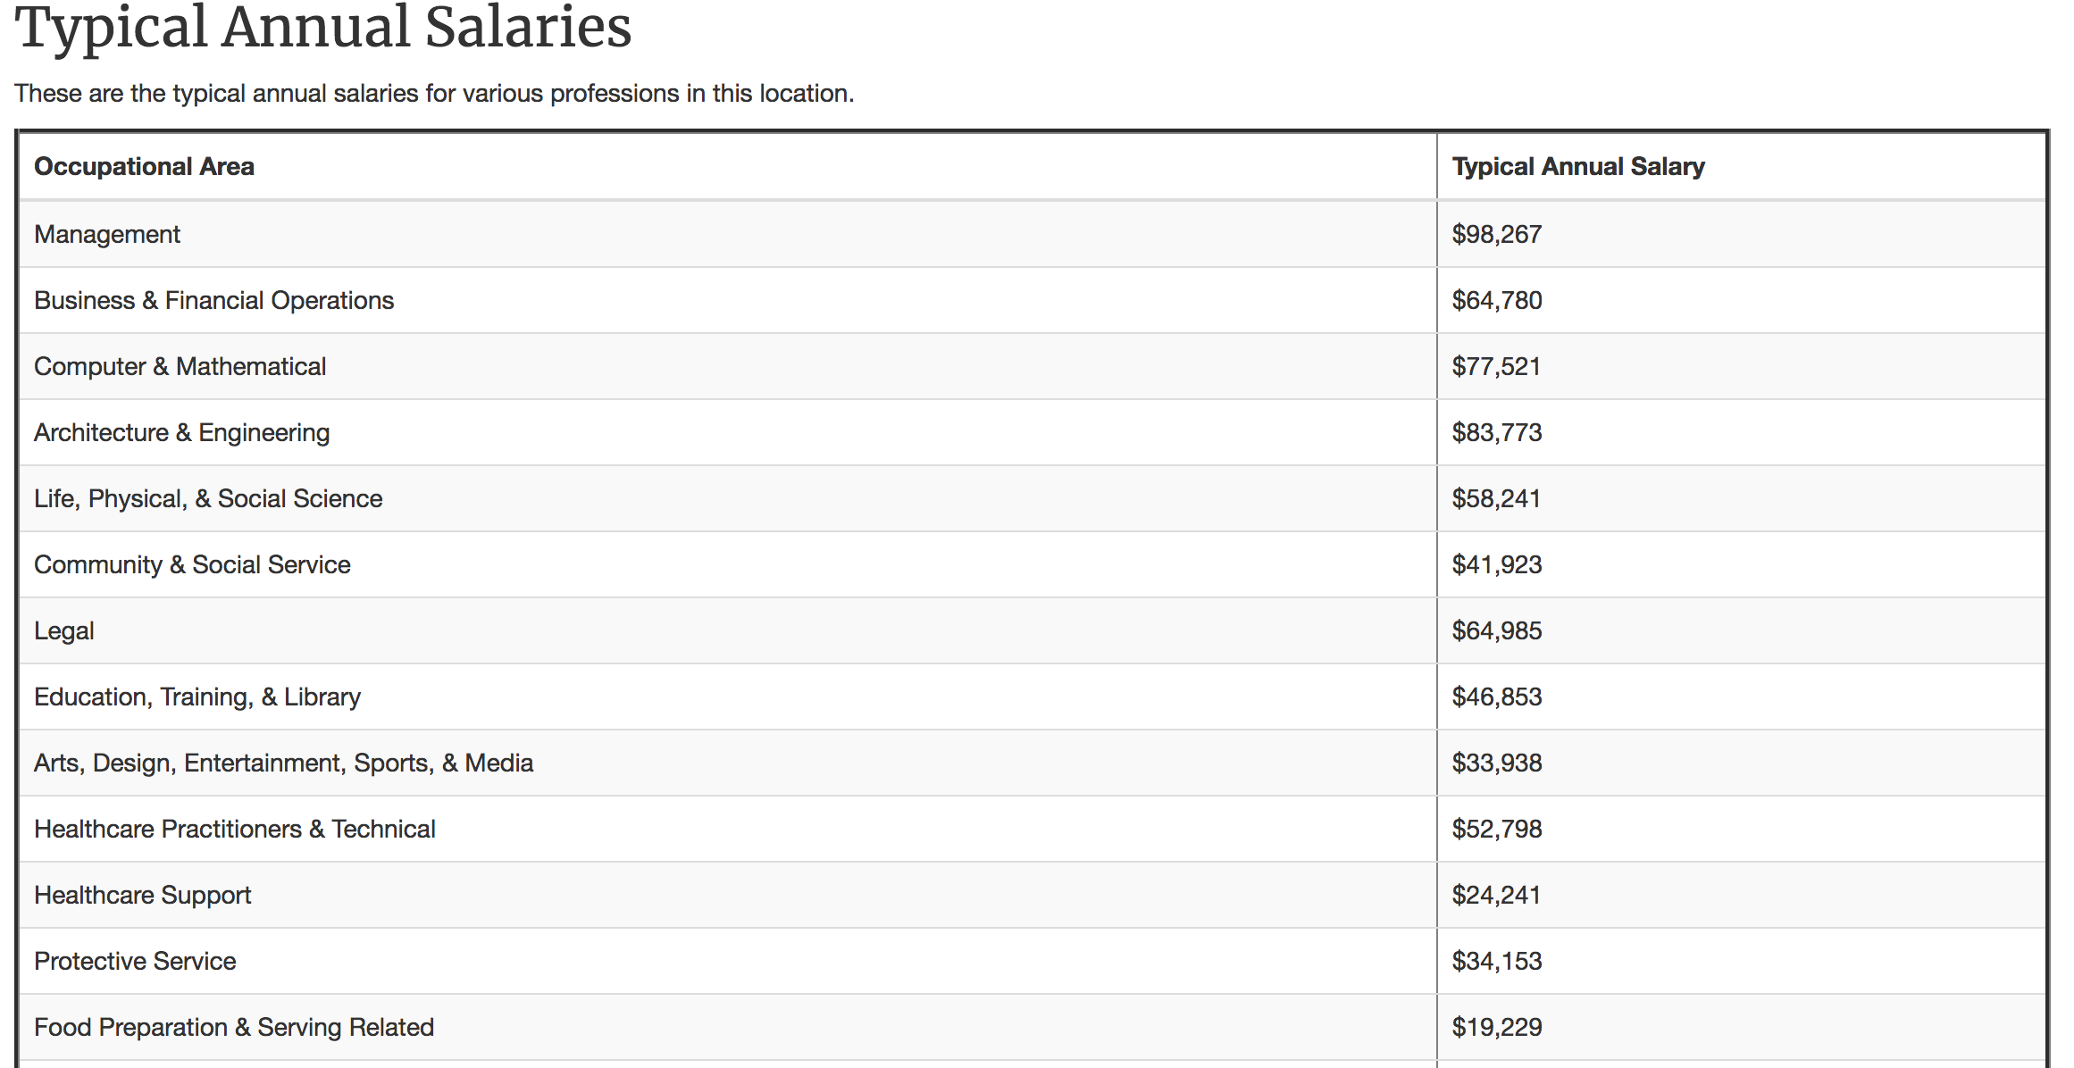
http://livingwage.mit.edu/
From these state links!
This table!

Slide 3
In the beginning…….
# giving URL a name
URL_Weber <- http://livingwage.mit.edu/counties/49057
#reading in the URL
read_html(URL_Weber)
# Giving the read URL a name
LW_Weber <- read_html(URL_Weber)
# Getting all of the table outall_tbls <- html_nodes(LW_Weber, "table")
# just getting the Occupations Table
occ_tbls <- html_nodes(LW_Weber, "table.occupations_table")
# Turning the List into a data.frame
html_table(occ_tbls)
# renaming the table Weber_Occ1
Weber_Occ1 <- html_table(occ_tbls[[1]])

Slide 4
functions on functions on functions on functions on functions on functions on functions on functions functions on functions
state_url_from_num = function(state_num)
{state_url = paste("http://livingwage.mit.edu/states/",state_num, sep = "")
return(state_url)
}
Input
Function
Output
EXAMPLE: State_url_from_num(“04”) = http://livingwage.mit.edu/states/04
_

Slide 5
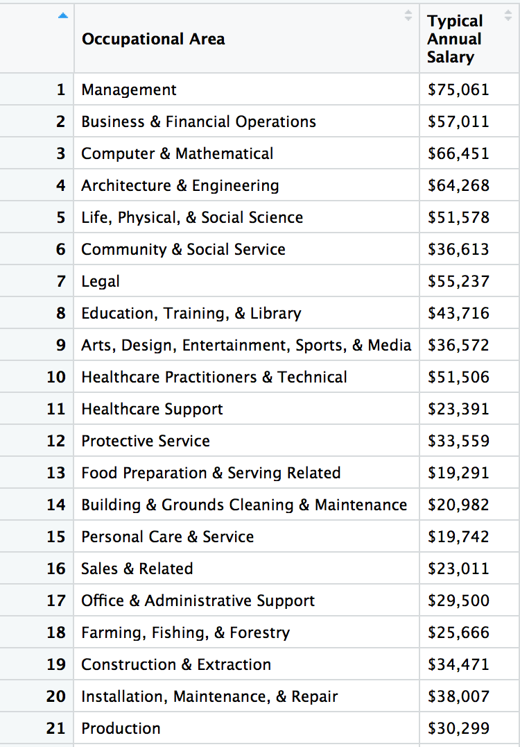
Input
Function
Output
get_occ_table_from_url = function(state_url) {
state_html <- read_html(state_url)
occ_node <- html_nodes(state_html, "table.occupations_table")
occ_table <- html_table(occ_node[[1]])
return(occ_table)
Grabs the table that we want from the html page using a CSS selector
Turns the html table into a data.frame
EXAMPLE:
get_occ_table_from_url(“http://livingwage.mit.edu/states/05”)
That’s seems too hard…..

Slide 6
get_occ_from_state_num2 = function(state_num){
state_url = state_url_from_num(state_num)
occ_table = get_occ_table_from_url(state_url) return(occ_table)
}
Example:
get_occ_from_state_num2(“05”)
Input
Function
Output
So much easier!!!

Slide 7
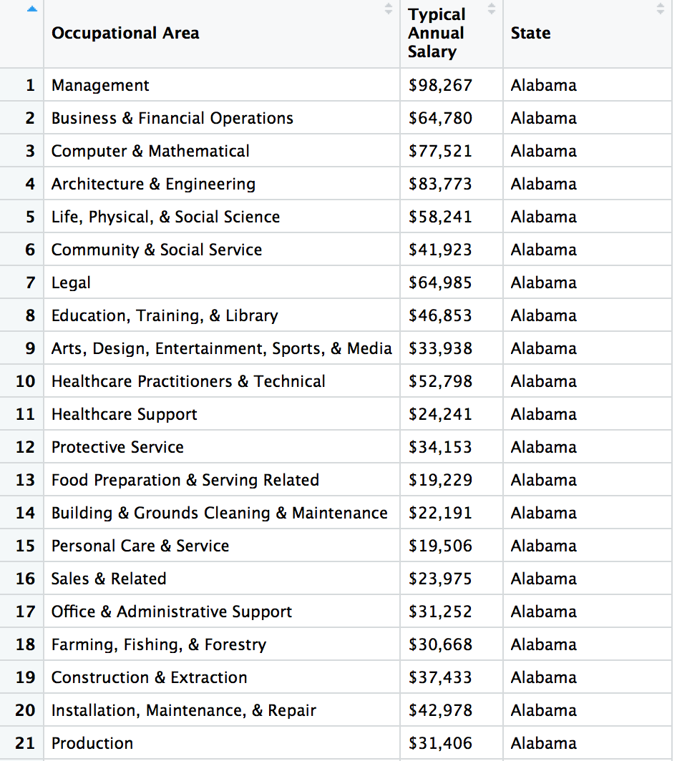
function.states = c("Alabama","Alaska","Arizona")
url_num = c("01", "02", "04”)
state_info = data.frame(
states,
url_num
)
gst = function(state_name,state_num){
Test_table <- get_occ_from_state_num2(state_num)
Test_table$State <- state_name
return(Test_table)}
State_Occupations = bind_rows(apply(state_info,1,function(row) gst(row[1],row[2])))
Input
Function
Output

Slide 8
Cleaned up the data…
Moved state to the left
- State_Occupations <- State_Occupations[,c(3,1:2)]
Changed the column names
names(State_Occupations)[names(State_Occupations) == 'Typical Annual Salary'] <- 'Annual_Salary'names(State_Occupations)[names(State_Occupations) == 'Occupational Area'] <- 'Occupational_Area'
Change to numeric…. Round one…
Took out the dollar sign
parse_number(State_Occupations$Annual_Salary)State_Occupations1 <- parse_number(State_Occupations$Annual_Salary)State_Occupations$Annual_Salary <- State_Occupations1
Change to Numeric… round two…
Change to numeric
State_Occupations$Annual_Salary <- as.numeric(State_Occupations$Annual_Salary)

Slide 9
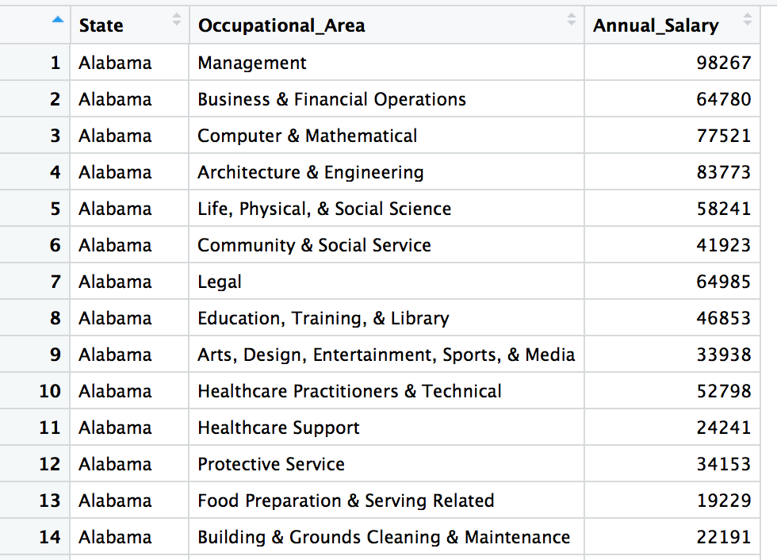
Behold!

Slide 10
What was the real assignment?
EDA!!!!!
In which field and which state is the highest paying job?
State Occupational_Area Annual_ Salary
District of Columbia Legal 153535

Slide 11
Compare Legal Salary in all States
This leads to more questions…

Slide 12
Fin

